Slide 1
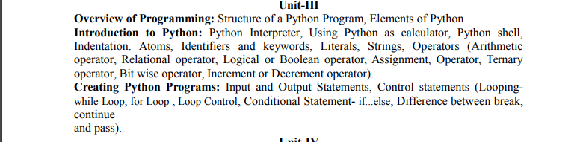

Slide 2
HLL to Machine Language
Suppose we want to add two numbers, the instructions that CPU actually carries out might be something like this:-
    Load the number from memory location 2001 into CPU.
    Load the number from memory location 2002 into CPU
    Add two number in CPU
    Store the result in location 2003.
Its complicated as instructions and numbers are represented in binary.
In High Level Languages, addition can be like
c = a+b.
But HLL needs to be converted into the language that computer can understand i.e. machine language.

Slide 3
HLL to Machine Language
There are two ways:
HLL can either be compiled or interpreted.

Slide 4
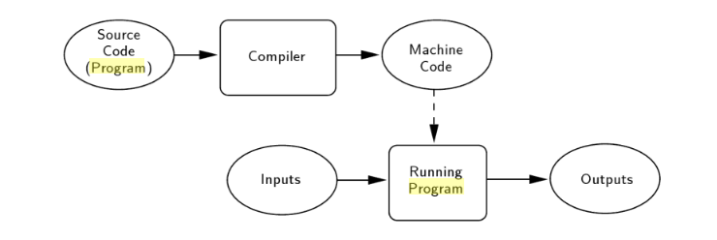
Compiler
A compiler takes entire program and converts it into object code which is typically stored in a file. The object code is also referred as binary code and can be directly executed by the machine after linking. Examples of compiled programming languages are C and C++.

Slide 5
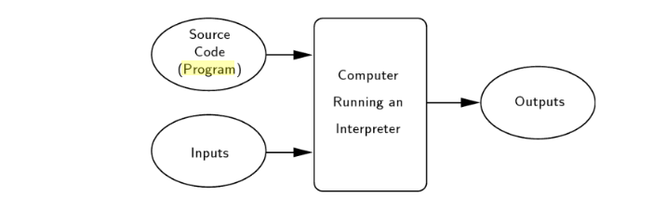
Interpreter
An Interpreter directly executes instructions written in a programming or scripting language without previously converting them to an object code or machine code. Rather than translating the source program into a machine language equivalent, the interpreter analyzes and executes the source code instruction by instruction as necessary.
Examples of interpreted languages are Perl, Python and Matlab.

Slide 6
Difference
Compiling is a one-shot translation, once a program is compiled, it may be run over and over again without further need of the compiler or the source code. In the interpreted case, the interpreter and the source are needed every time the program runs.
Compiled programs tend to be faster since the translation is done once and for all, but interpreted languages lend themselves to a more flexible programming environment as programs can be developed and run interactively.

Slide 7
Python
Python is a high-level, interpreted, interactive, object-oriented and dynamic typed scripting language.
Python was created by Guido Van Rossum and first released in 1991.

Slide 8
Features of Python
Easy to Code:
    Python is high level programming language. Python is easy to learn language as compared to other languages like C, C#, Java Script , java etc.
Free and Open Source:
    Python language is freely available at official website. Since, it is open-source, this means that the source code is also available to the public.

Slide 9
Features of Python
Object-Oriented Language:
    Python supports object oriented language features i.e. concept of classes, objects encapsulation etc.
GUI Programming Support:
    Graphical User Interfaces can be made using module such as PyQT5, Tk in python.
High Level Language:
    Python is a high level language. When we write programs in python, we do not need to remember the system architecture, nor do we need to manage the memory.

Slide 10
Features of Python
Extensible feature:
    Python is extensible language, we can write our some python code into c or C++ language and can also compile that code in C/C++ language.
Python is Portable language:
    If we have python code for windows and if we want to run this code on other platform such as Linux, Unix and Mac then we do not need to change it, we can run the same code on any platform.

Slide 11
Features of Python
Python is integrated language:
    We can easily integrate python with other language like C or C++ etc.
Interpreted Language:
    Python is an interpreted language because python code is executed line by line at a time.
Large standard library:
    Python has a large standard library which provides rich set of module and functions so you do not have to write your own code for every single thing. There are many libraries present in python for such as regular expressions, unit-testing, web browsers etc.

Slide 12
Features of Python
Dynamically Typed Language:
    That means the type for a variable is decided at run time not in advance because of this feature we don’t need to specify the type of variable.

Slide 13
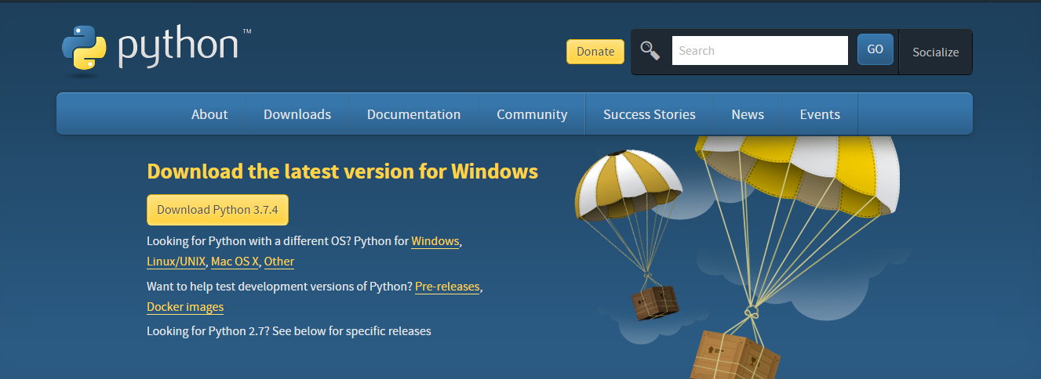
We are going to use Python 3.7.4

Slide 14
IDLE
IDLE is Python’s Integrated Development and Learning Environment.
IDLE has two main window types, the Shell window and the Editor window.

Slide 15
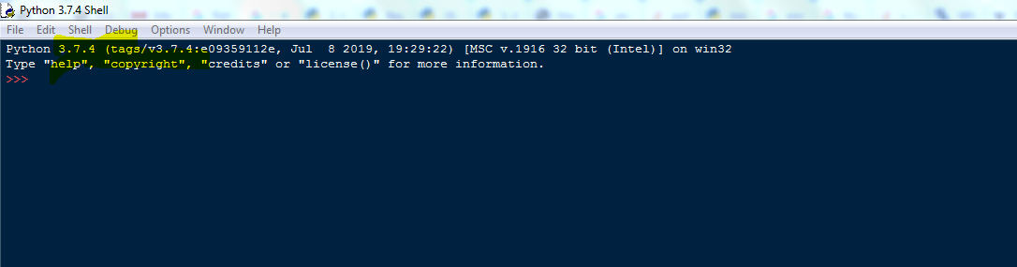
Python Interpreter
When commands are read from a tty, the interpreter is said to be in interactive mode. In this mode it prompts for the next command with the primary prompt, usually three greater-than signs (>>>); for continuation lines it prompts with the secondary prompt, by default three dots (...).
The interpreter prints a welcome message stating its version number and a copyright notice before printing the first prompt:

Slide 16
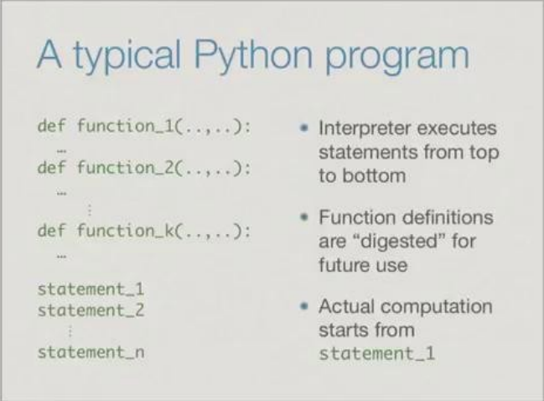
A typical python program

Slide 17
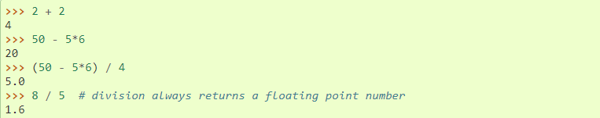
Using Python as a calculator
The interpreter acts as a simple calculator: you can type an expression at it and it will write the value.
Expression syntax is straightforward: the operators +, -, * and / work just like in most other languages (for example, Pascal or C); parentheses (()) can be used for grouping.
For example:

Slide 18


Using Python as a calculator
With Python, it is possible to use the ** operator to calculate powers
The equal sign (=) is used to assign a value to a variable. Afterwards, no result is displayed before the next interactive prompt:

Slide 19
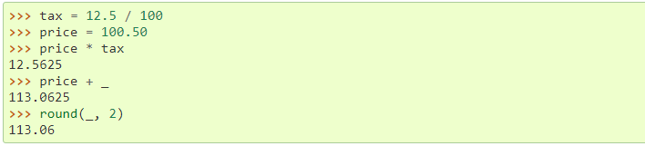
Using Python as a calculator
In interactive mode, the last printed expression is assigned to the variable _. This means that when you are using Python as a desk calculator, it is somewhat easier to continue calculations, for example:

Slide 20
Indentation
Whitespace is used for indentation in Python. All statements with the same distance to the right belong to the same block of code.
If a block has to be more deeply nested, it is simply indented further to the right.
Most of the programming languages like C, C++, Java use braces { } to define a block of code. One of the distinctive features of Python is its use of indentation to highlight the blocks of code.
To indicate a block of code in Python, you must indent each line of the block by the same whitespace.

Slide 21
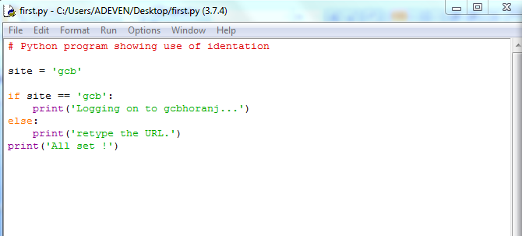
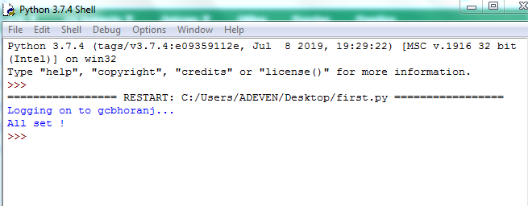
Indentation

Slide 22
Indentation
The lines print(‘Logging on to gcbhoranj…’) and print(‘retype the URL.’) are two separate code blocks.
The two blocks of code in our example if-statement are both indented four spaces.
The final print(‘All set!’) is not indented, and so it does not belong to the else-block.

Slide 23
Comments
A comment in a computer program is text that is intended only for the human reader — it is completely ignored by the interpreter.
In Python, the # token starts a comment. The rest of the line is ignored.
As programs get bigger and more complicated, they get more difficult to read. Formal languages are dense, and it is often difficult to look at a piece of code and figure out what it is doing, or why. For this reason, it is a good idea to add notes (comments) to your programs to explain in natural language what the program is doing.

Slide 24
Python Identifiers
A Python identifier is a name used to identify a variable, function, class, module or other object. An identifier starts with a letter A to Z or a to z or an underscore (_) followed by zero or more letters, underscores and digits (0 to 9).
Python does not allow punctuation characters such as @, $, and % within identifiers.
Python is a case sensitive programming language. Thus, Manpower and manpower are two different identifiers in Python.

Slide 28
Variable in Python
A variable, as the name indicates is something whose value is changeable over time.
In fact a variable is a memory location where a value can be stored. Later we can retrieve the value to use.
But for doing it we need to give a nickname to that memory location so that we can refer to it. That’s identifier, the nickname.

Slide 29
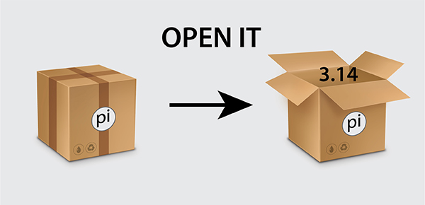
Variable in Python

Slide 30
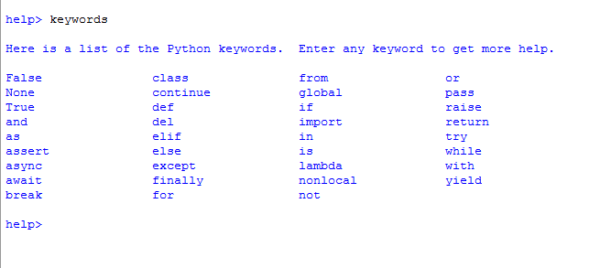
Python Keywords
Keywords are special words which are reserved and have a specific meaning. Python has a set of keywords that cannot be used as variables in programs.
All keywords in Python are case sensitive.

Slide 31
Assignment Statement
The assignment statement gives a value to a variable:
>>> message = "What's up?"
>>> n = 17
>>> pi = 3.14159
This example makes three assignments.
The first assigns the string value "What's up?" to a variable named message.
The second gives the integer 17 to n,
and the third assigns the floating-point number 3.14159 to a variable called pi.

Slide 32
Assignment Statement
The assignment statement binds a name, on the left-hand side of the operator to a value on the right-hand side.

Slide 33
Evaluating expressions
An expression is a combination of values, variables, operators, and calls to functions. If you type an expression at the Python prompt, the interpreter evaluates it and displays the result:
>>> 1 + 1
2
>>> len("hello")
5
In this example len is a built-in Python function that returns the number of characters in a string.

Slide 34
Operators and operands
Operators are special tokens that represent computations like addition, multiplication and division. The values the operator uses are called operands.
The following are all legal Python expressions

Slide 35
Operators and operands
The tokens +, -, and *, and the use of parenthesis for grouping, mean in Python what they mean in mathematics.
The asterisk (*) is the token for multiplication, and ** is the token for exponentiation.

Slide 36
Operators and operands
In Python 3, the division operator / always yields a floating point result.
Python gives us two different flavors of the division operator.
The second, called floor division uses the token //.
Its result is always a whole number — and if it has to adjust the number it always moves it to the left on the number line. So 6 // 4 yields 1

Slide 41
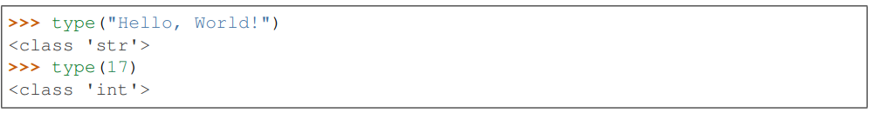
Type function in Python
Python has a function called type, which tells which class i.e. int, float or string a value falls into.

Slide 42
Strings in Python can be enclosed in either single quotes (') or double quotes ("), or three of each (''' or """).
Double quoted strings can contain single quotes inside them, as in "Bruce's beard", and single quoted strings can have double quotes inside them, as in 'The knights who say "Ni!"'.

Slide 43
Type converter functions
In Python, the type converter functions are:
  int
  float
  str

Slide 44
Type converter functions
The int function can take a floating point number or a string, and turn it into an int.
For floating point numbers, it discards the decimal portion of the number — a process we call truncation towards zero on the number line.

Slide 45
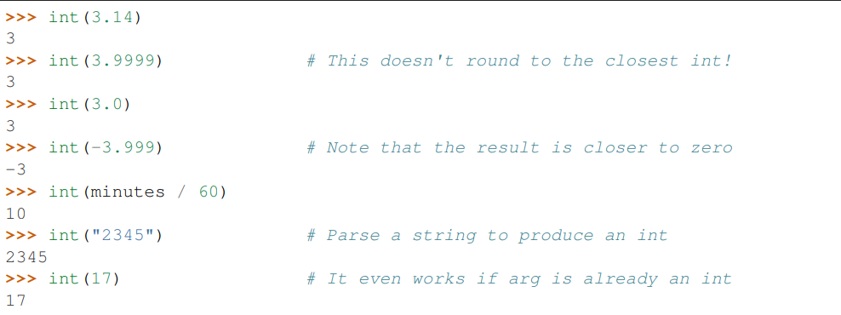
Type converter functions

Slide 46
Type converter functions
The type converter float can turn an integer, a float, or a syntactically legal string into a float:
>>> float(17)
17.0 >>>
float("123.45")
123.45

Slide 47
Type converter functions
The type converter str turns its argument into a string:
>>> str(17)
'17‘
>>> str(123.45)
'123.45'

Slide 48
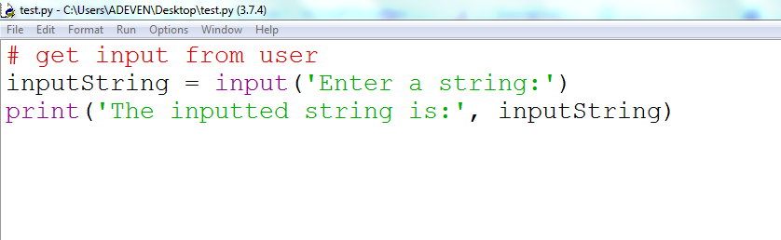
Input Function in Python
The input() method reads a line from input, converts into a string and returns it.
The syntax of input() method is:
  input([prompt])

Slide 49
Input Function in Python
Even if you asked the user to enter their age, you would get back a string like "17". It would be your job, as the programmer, to convert that string into a int or a float, using the int or float converter functions.

Slide 50
Print function in Python
The print() function prints the specified message to the screen, or other standard output device.

Slide 51
Programming Assignment
WAP to calculate total marks and percentage of a student. Marks obtained in each of the three subjects are to be input by the user.

Slide 52
Arithmetic operators
Arithmetic operators are used to perform mathematical operations like addition, subtraction, multiplication etc.

Slide 53
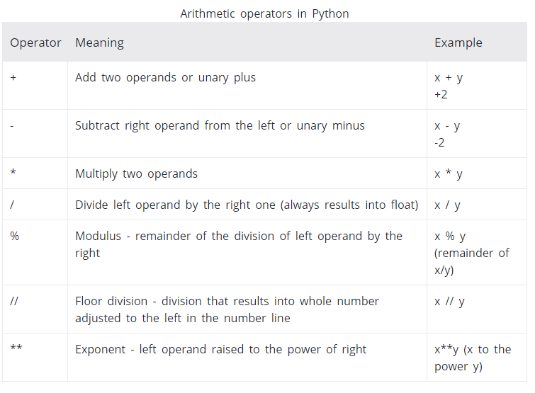

Slide 54
Comparison Operators
Comparison operators are used to compare values.
It either returns True or False according to the condition.

Slide 55
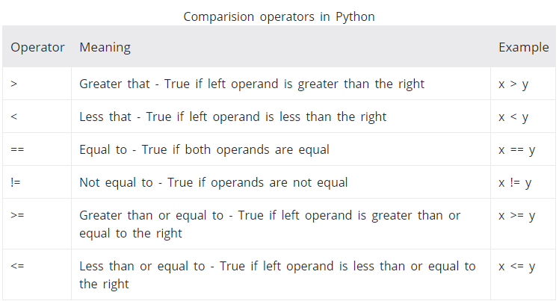

Slide 56
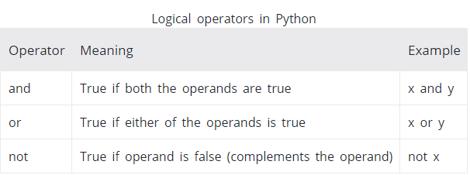
Logical Operators
Logical operators are and, or, not operators.

Slide 57
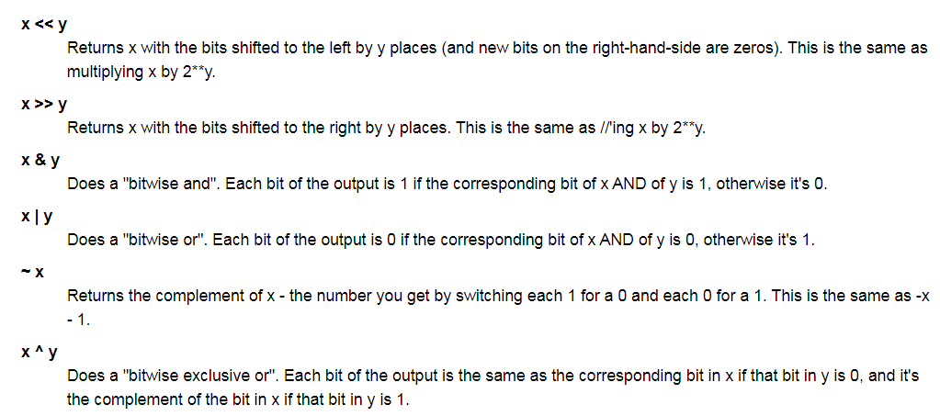
Bitwise operators
Bitwise operators act on operands as if they were string of binary digits. It operates bit by bit, hence the name.

Slide 58
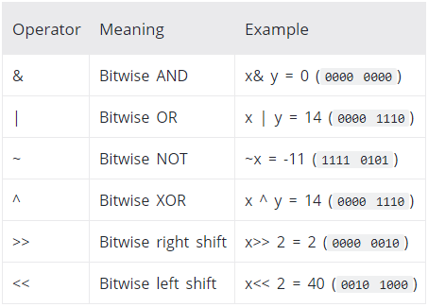
Bitwise operators
For example, 2 is 10 in binary and 7 is 111.

Slide 59
Assignment operators
Assignment operators are used to assign values to the variables.

Slide 60
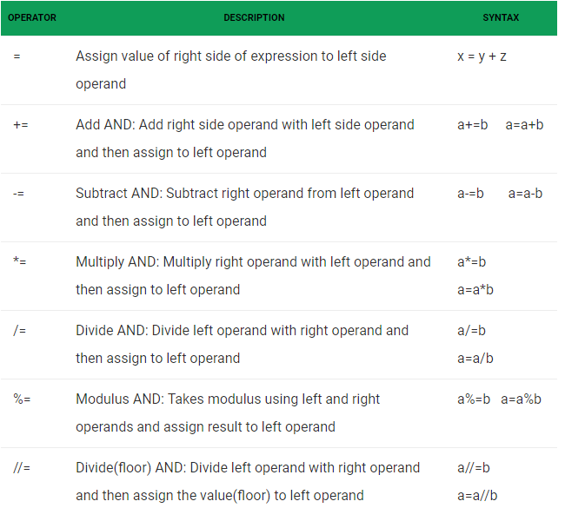

Slide 61
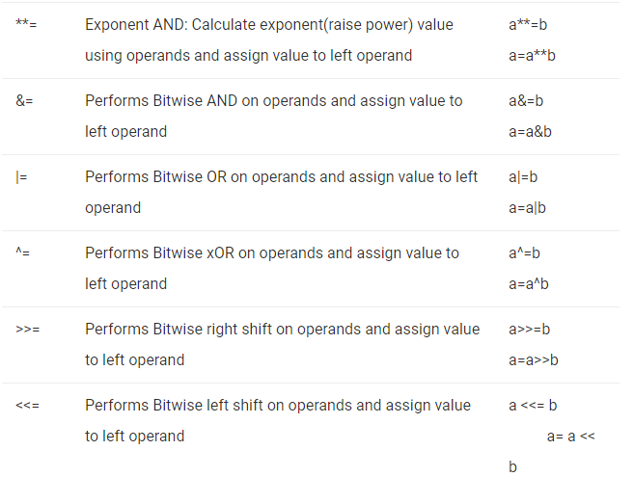

Slide 62
Python Continue Statement
The continue statement gives you way to skip over the current iteration of any loop.
When a continue statement is encountered in the loop, the python interpreter ignore rest of statements in the loop body for current iteration and returns the program execution to the very first statement in the loop body.
It does not terminates the loop rather continues with the next iteration.
Syntax:
continue

